Slide 1
Chapter 5-7
Process Analysis

Slide 2
Outline
Introduction
Flowcharting of processes
Types of processes:
Production Process (Chapter 6)
Service Process (Chapter 7)

Slide 3
Process
“A process is a transformation of inputs into outputs.”
Process
Information
structure
Network of
Activities and Buffers
Inputs
Outputs
Goods
Services
Flow units
(customers, data,
material, cash, etc.)
Labor & Capital
Resources

Slide 4
Process Flowcharting
It is an ideal methodology by which to begin analyzing a process
Use of a diagram to present the major elements of a process.
The basic elements can include
  Tasks or operations,
  Flows of materials or customers,
  Decision points, and
  Storage areas or queues
Notes:
4

Slide 5
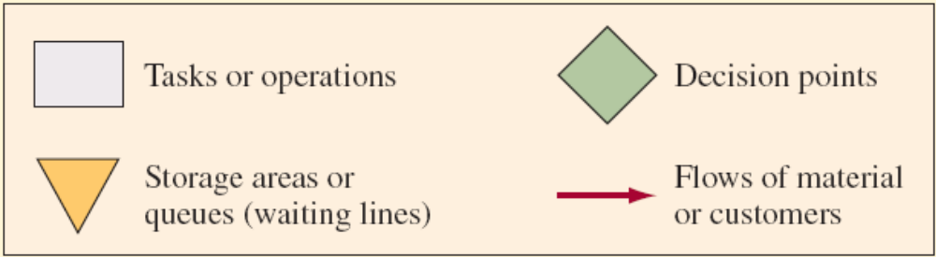
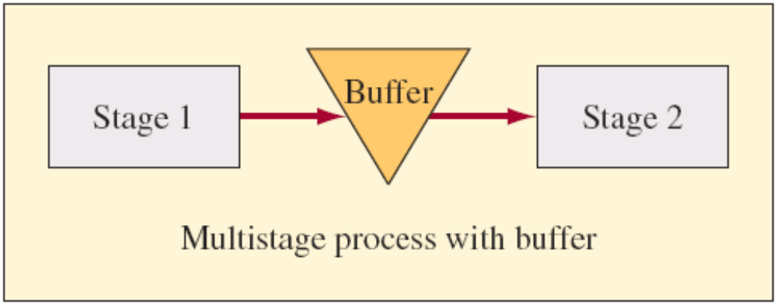
Flowchart Symbols

Slide 6
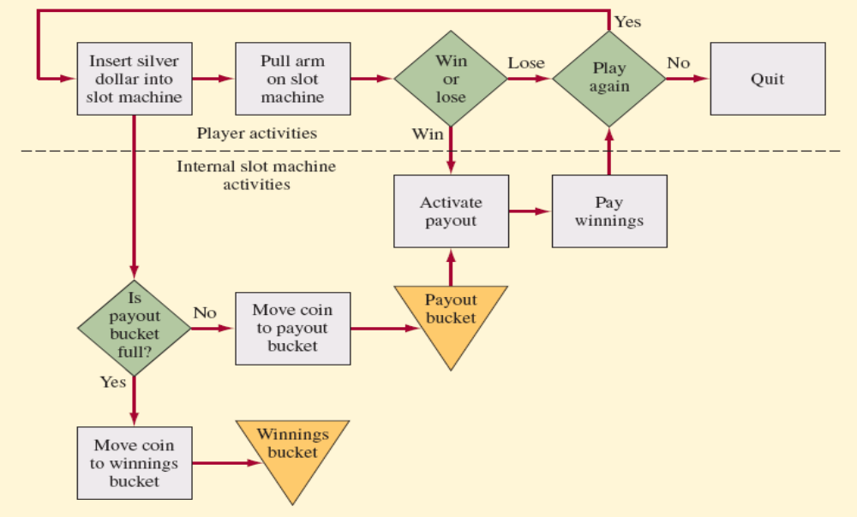
Process Flowchart Example (Slot Machine page 111)

Slide 7
Terminology
Buffer: a storage area between stages where the output of a stage is placed prior to being used in a downstream stage
Blocking: occurs when the activities in a stage must stop because there is no place to deposit the item
Starving: occurs when the activities in a stage must stop because there is no work
Bottleneck: stage that limits the capacity of the process

Slide 8
Types of Processes
Single Stage
Multiple Stages
Production Process (Chapter 6)
Services Process (Chapter 7)
Stage 1
Stage 2
Stage 3
Notes:
4

Slide 9
Outline
Introduction
Flowcharting of processes
Types of processes:
Production Process (Chapter 6)
Service Process (Chapter 7)

Slide 10
Production Process
Production processes are used to make all the tangible goods
Customer order decoupling point: where inventory is positioned to allow entities in the supply chain to operate independently

Slide 11
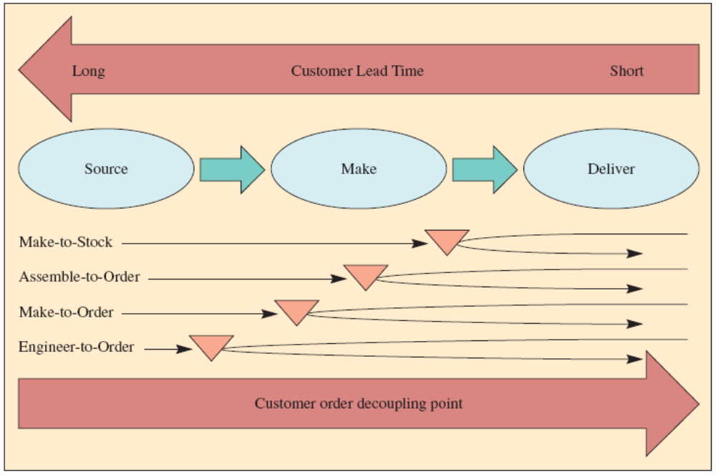
Types of firms (based on decoupling point)

Slide 12
Types of Firms (Cont.)
Make-to-Stock
Assemble-to-Order
Make-to-Order
Engineer-to-Order
Serve customers from finished goods inventory
Combine a number of preassembled modules to meet a customer’s specifications
Make the customer’s product from raw materials, parts, and components
Work with the customer to design and then make the product

Slide 13
How Production Processes are Organized
Five basic structures:
Project
Workcenter (job shop)
Manufacturing cell
Assembly line
Continuous process
Notes:
11

Slide 14
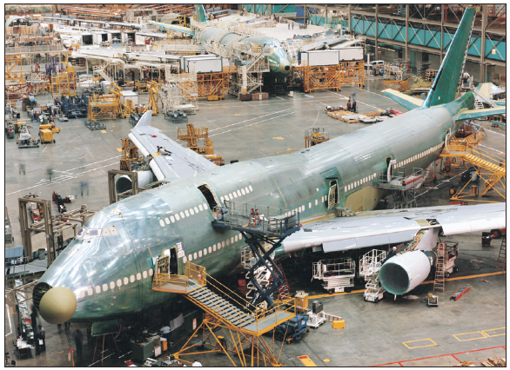
1. Project
The product remains in a fixed location
  Manufacturing equipment is moved to the product
  Eg. Airplane
  Using project management techniques (Chapter 10)

Slide 15
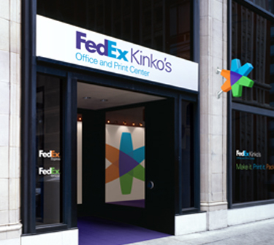
2. Workcenter
Similar equipment or functions are grouped together
To optimizes the movement of material
Sometimes is referred to as a department and is focused on a particular type of operation

Slide 16
3. Manufacturing Cell
Group products that are similar in processing requirements or common sequence of steps
Dissimilar machines and the associated processes are physically regrouped into cells

Slide 17
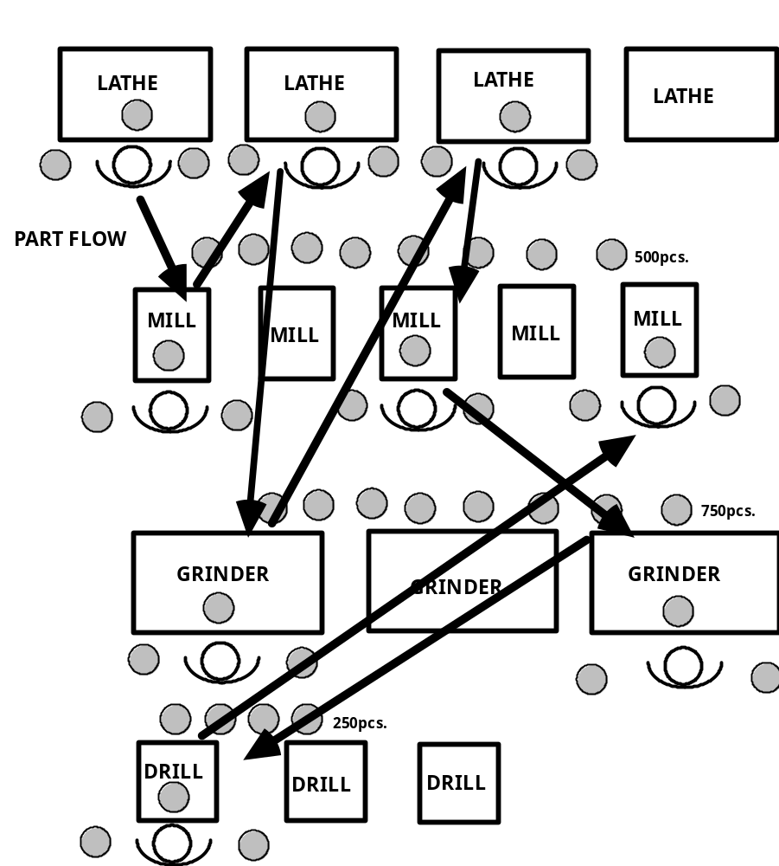
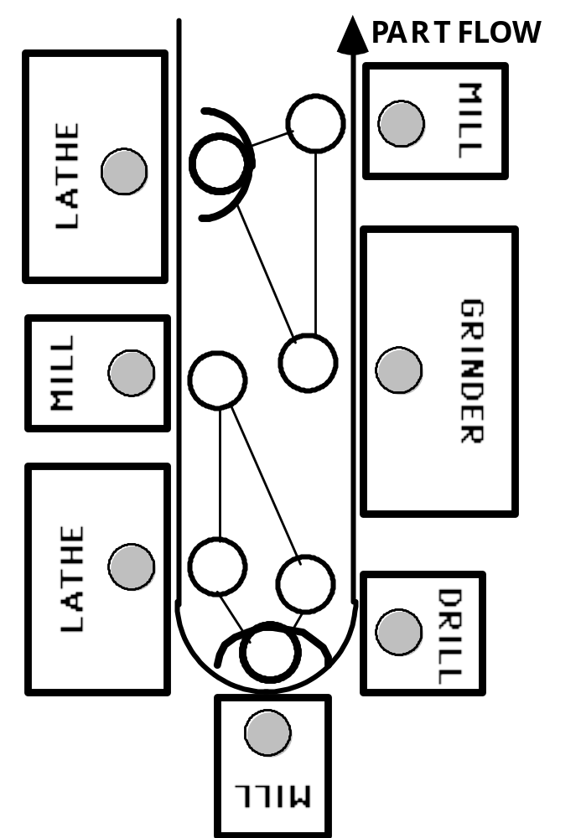
Workcenter Vs. Manufacturing Cell

Slide 18
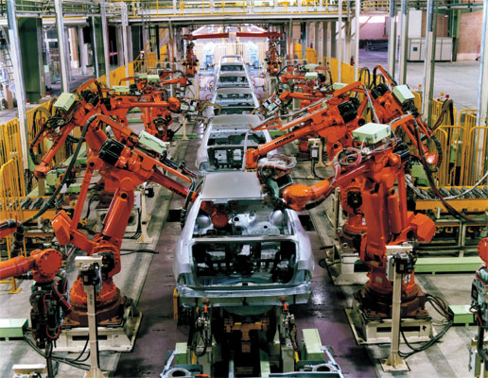
4. Assembly Line Design
Work processes are arranged according to the progressive steps by which the product is made
Video: Ford Model T-The success of Assembly Line

Slide 19
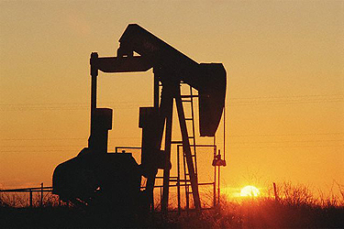
5. Continuous Process
Like assembly line but the flow is continuous such as liquids

Slide 20
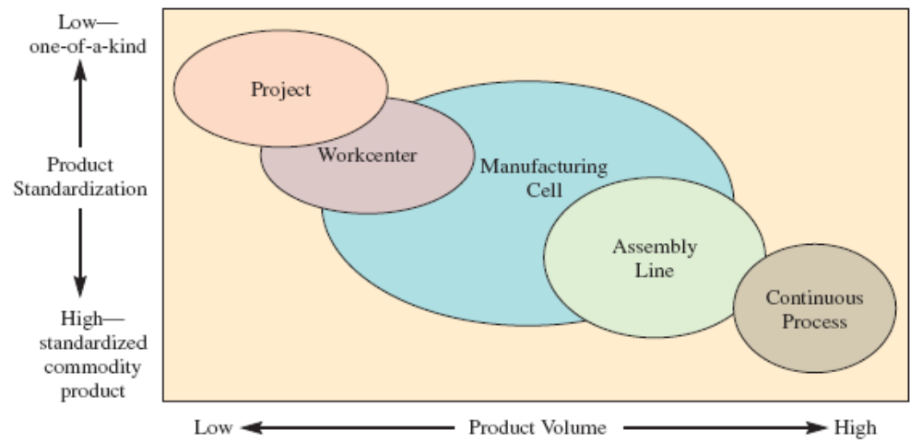
Product–Process Matrix
Video: Production Process

Slide 21
Break-Even Analysis
To determine the point in units (Break-Even Point) produced where a company will start making profit on the process.
  Total revenue and total cost are equal.
To choose among alternative processes or equipment.
  E.g. To buy or to make?
  Total cost to buy and total cost to make are equal.

Slide 22
Example of Break-Even Analysis
A book publisher has fixed costs of $300,000 and variable costs per book of $8.00. The book sells for $23.00
  How many books must be sold to break-even? (find the break-even point)
  What is the revenue at the break-even point?

Slide 23
Example of Break-Even Analysis (Cont.)
A book publisher has fixed costs of $300,000 and variable costs per book of $8.00. The book sells for $23.00
  How many books must be sold to break-even? (find the break-even point)
  Total cost = Total revenue
  300,000+8*X = 23*X
  300,000=15X
  X=300,000/15 = 20,000
  What is the revenue at the break-even point?
  Total revenue = 23*20,000 = $460,000

Slide 24
Outline
Introduction
Flowcharting of processes
Types of processes:
Production Process (Chapter 6)
  Introduction to production process
  Organize production processes
  Product-process matrix
  Break-even analysis
Service Process (Chapter 7)

Slide 25
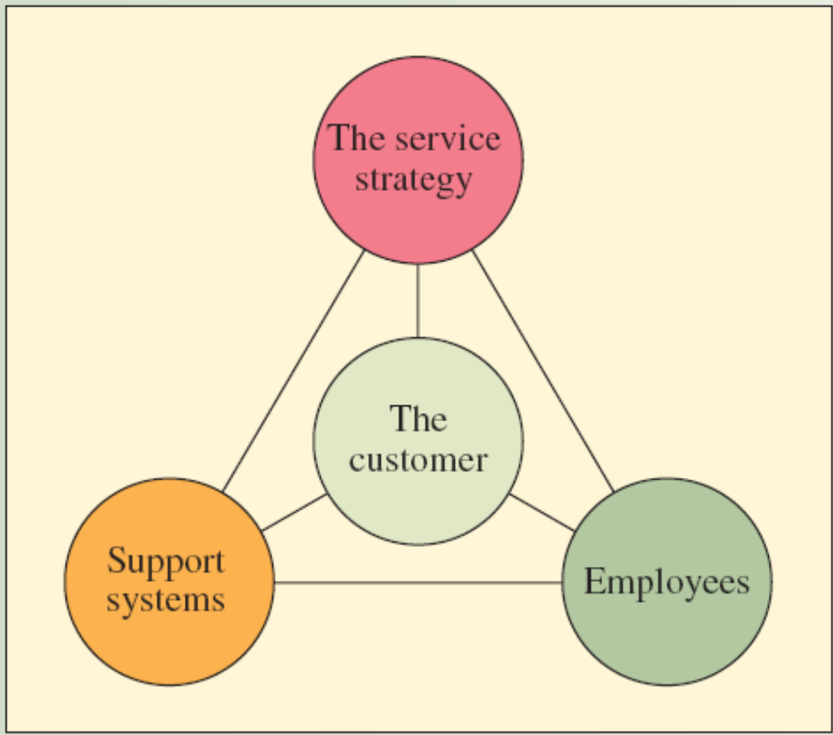
Service Package

Slide 26

SUPPLY CHAIN SERVICES AT DHL
DHL offers customers a variety of value-added supply chain related services
  Delivering packages
  Improving efficiencies and
  Reducing costs
  Eg. Order management, call center management, global inventory management, consolidated billing services, freight and customs solutions

Slide 27
Service vs. manufacturing
Services are intangible comparing with manufacturing
Services cannot be stored in inventory
In services, capacity becomes the dominant issue
  Too much capacity leads to excessive costs
  Insufficient capacity leads to lost customers

Slide 28

SCM in healthcare
Healthcare supply chains remain underdeveloped due to their special characteristics
  Difficulty in forecasting demand
  Relatively short shelf life
  High profit margins
  Lack of qualified supply chain
  professionals

Slide 29

Waiting line management
Waiting line models provide a powerful mathematical tool for analyzing many service situations:
  Tellers needed in a bank
  Computer servers needed in an Internet service operation
  Seats needed at the waiting room

Slide 30
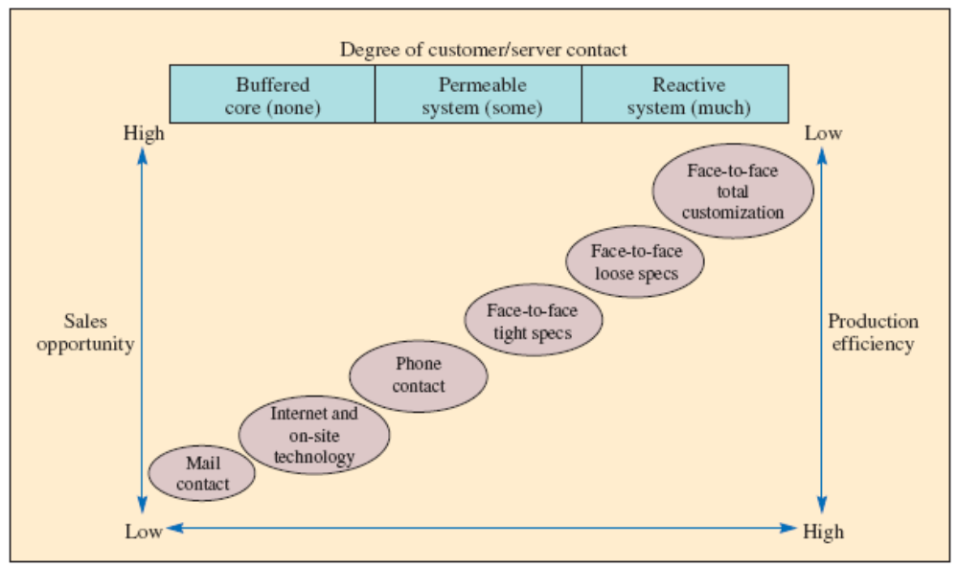
Service system design matrix
- Structuring the Service Encounter

Slide 31

Virtual Service: The New Role of the Customer
Virtual customer contact: where companies enable customers to interact with one another in an open environment
  eBay
  YouTube
  WikiPedia
  Facebook
  Twitter
  Second Life
Web 2.0 and social medias

Slide 32
Summary
Introduction to process
Flowchart of process
Types of processes:
Production Process (Chapter 6)
  Introduction to production process
  Organize production processes
  Product-process matrix
  Break-even analysis
Service Process (Chapter 7)
  Characteristics of service processes
    how differ from manufacturing processes
  Design the service system
  Involvement of the customer in services: Virtual Service

